Slide 1


Who Wants to
Be a Millionaire?
Notes:
Lifeline icons on the question slides are hyperlinks which will take you to the lifeline screen. To return to the game, you may right click on the screen, choose Go, Previously Viewed. This should return you to the question slide. Alternatively, left click as usual to return to the game board, then click on the highest number that has been previously selected (in gold to indicate a followed hyperlink).
To utilize the 50:50 option, the moderator may tell the contestant which two options to disregard or, use Control-P to change the mouse arrow to a pen. Draw a line through two incorrect responses, then use Control-A to change the pen back into an arrow and continue with the game.
Clicking on the action button on the phone handset image of the Phone a Friend lifeline slide will hyperlink to the Ask Jeeves web site where the participant may ask for help.

Slide 2


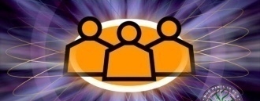
1,000,000
500,000
250,000
125,000
64,000
32,000
16,000
8,000
4,000
2,000
1,000
500
300
200
100

Slide 3


Click to return to question, Cont-P to switch to the pen, cross out two incorrect answers, then Cont-A to switch back to pointer.

Slide 4

Click to return to the question and poll the class

Slide 5

Click on link to Ask Jeeves, or click on this oval to return to question and ask a friend

Slide 6
Who sings my life would suck without you?
A. Kelly Clarkson
B. Nelly Furtado
C. Hannah Montana
D. Taylor Swift

Slide 7
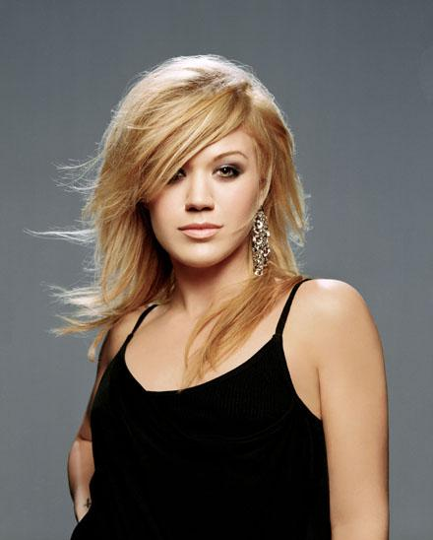
A. Kelly Clarkson
Back to Board

Slide 8
Who plays Sophie on shortland street?
A. Nicole Crossman
B. Courtney Crossman
C. Kimberly Crossman
D. Kelly Crossman

Slide 9
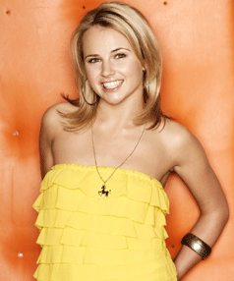
C. Kimberley Crossman
Back to Board

Slide 10
Who sings the driveway?
A. Hannah Montana
B. Miley Cyrus
C. Lady Gaga
D. Tracey Chapman

Slide 11
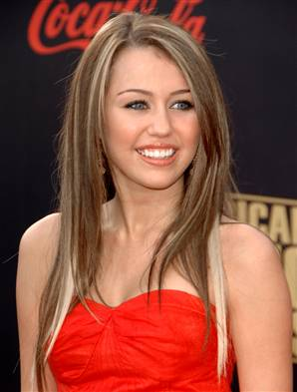
B. Miley Cyrus
Back to Board

Slide 12
Who plays Nim on Nims island
A. Abigail Breslin
B. Miranda Cosgrove
C. Roxy Hunter
D. Annasophia Robb

Slide 13
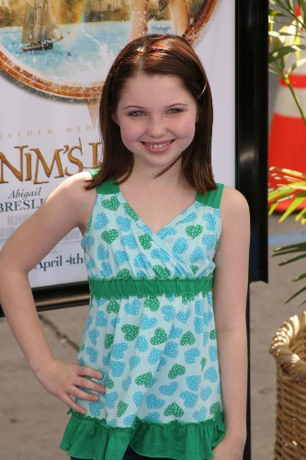
A. Abigail Breslin
Back to Board

Slide 14
Who sings love story?
A. Katie Perry
B. Taylor Momsen
C. KT Tunstall
D. Taylor Swift

Slide 15
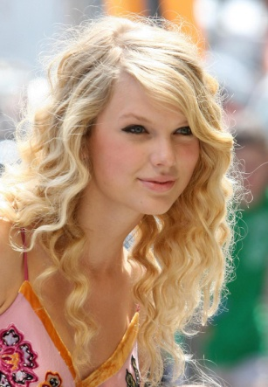
D. Taylor Swift
Back to Board

Slide 16
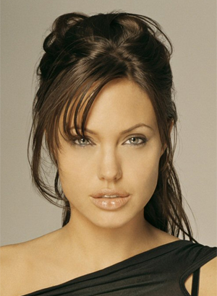
Who is this?
A. Emma Watson
B. Miley Cyrus
C. Angelina Jolie
D. Vanessa Hugens

Slide 17
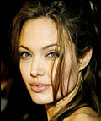
C. Angelina Jolie
Back to Board

Slide 18
Who sings run Rudolf run?
A. Jonas Brothers
B. Billy Ray Cyrus
C. Michel Jackson
D. Britany Spears

Slide 19
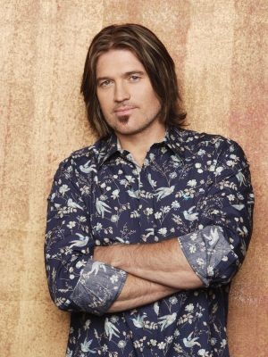
B. Billy Ray Cyrus
Back to Board

Slide 20
Who made a hit appearance on Hannah Montana?
A. Neyo
B. Demi Lovato
C. Selena Gomez
D. Tyra Banks

Slide 21
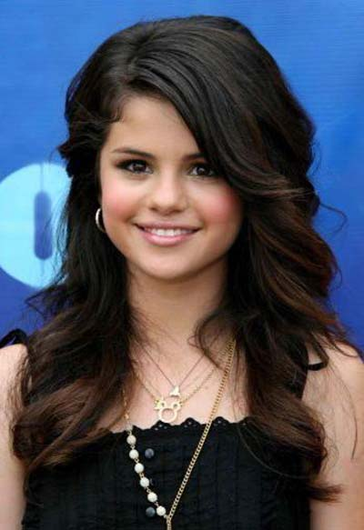
C. Selena Gomez
Back to Board

Slide 22
What on and off screen couple are
together ?
A. Rihanna & Chris
Brown
B. Miley Cyrus &
Nick Jonas
C. Taylor Swift &
Joe Jonas
D. Vanessa Hudgens &
Zac Efron

Slide 23
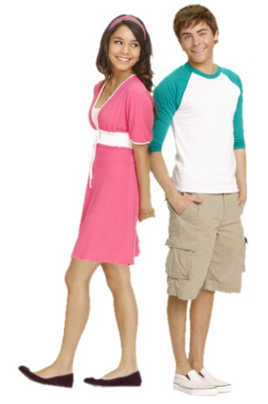
D. Vanessa and Zac
Back to Board

Slide 24
Who's the host of Americas next
Top model ?
A. Taylor Banks
B. Tyra Banks
C. Tiffany Banks
D. Tiara Banks

Slide 25
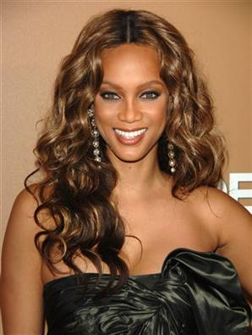
B. Tyra Banks
Back to Board

Slide 26
Who was the last girl to get
Eliminated in American idol 2009?
A. Alison
B. Keke Palmer
C. Kelly Clarkson
D. Anna

Slide 27
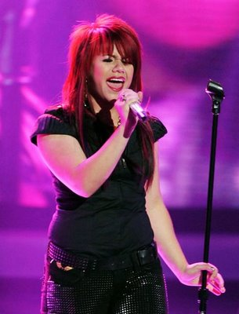
A. Alison
Back to Board

Slide 28
Who's miley Cyrus’s best friend?
A. Ashley Tisdale
B. Taylor Swift
C. Emily Osment
D. Demi Lovato

Slide 29
B. Taylor Swift
Back to Board

Slide 30
Who’s the most famous NZ band?
A. Smash proof
B. Matchbox 20
C. Opshop
D. Evermore

Slide 31
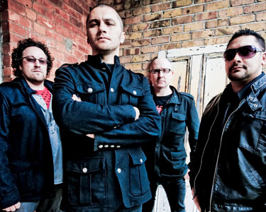
C. OPSHOP
Back to Board

Slide 32
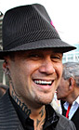
Who is this?
A. Jesse McCartney
B. Nick Jonas
C. Zac Efron
D. Tiki Taane

Slide 33
D. Tiki Taane
Back to Board

Slide 34
What is Miley little sisters
Name?
A. Noah
B. Kate
C. Brandi
D. Miley

Slide 35
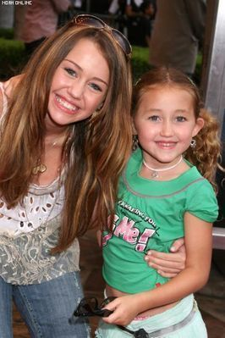
A. Noah!!!

Slide 36
Sorry, try again!

Slide 37
Thanks for playing!

